Slide 1
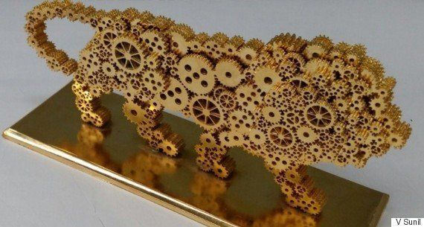
We are the industrial Consultant ,Machine designer ,Manufacturer,Traders,Expoters Executers of large and small scale industries, we are working since last 20 years ,
in hand engineering graduate dedicated team and also technical support team, we already installed about 1500 large, medium and small scale industries through out India and abroad working successfully .
If you have any enquire,quries ,and technical clarification please feel free to reach us on cell : 0091-7989027253,8179527065 , Email :bestomechines@gmail.com

Slide 2
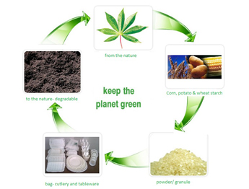
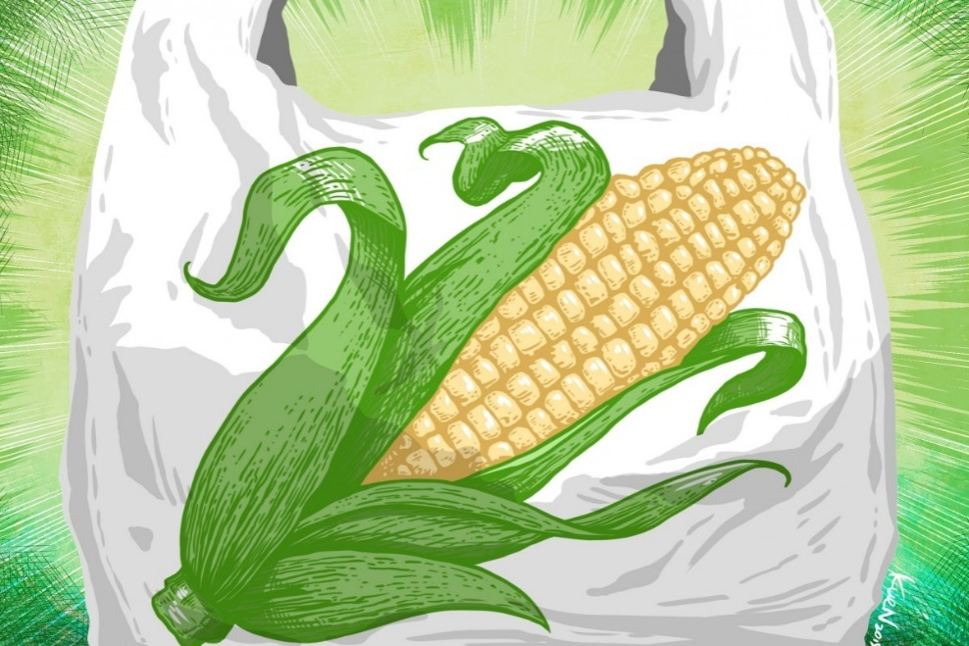
Biodegradable
Biodegradable (adjective of a substance or object) : capable of being decomposed by bacteria or other living organisms and thereby avoiding pollution lick to
प्राकृतिक परिस्थितियों में अपघटनीय पदार्थ

Slide 3
The Problem (read Market)
Conventional carry bags has been banned
Central Government has made it mandatory to stop use of single use plastics by February 2022.
Supply chain system of the product is well established
Customers are unable to change there habit of using carry bag as its very convenient
So MSME has an opportunity here,

Slide 4
Opportunity
End No of uses are there with the Bio-Degradable Plastic
Carry bags
Agriculture Warp sheets
Dinning warp sheets
Seed packing bags
Food grades items packings
Garbage bags
Exports packings etc .

Slide 5
Go for green India soon
We have plans to facilitate & promote good numbers of units in India thus becoming the pioneer country
Pollution free and green country
“पहला हमेशा पहला”

Slide 6
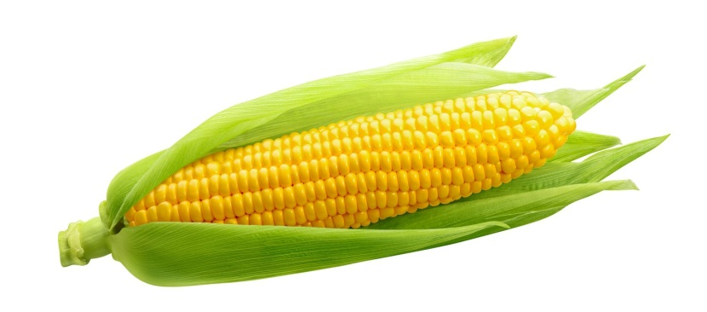
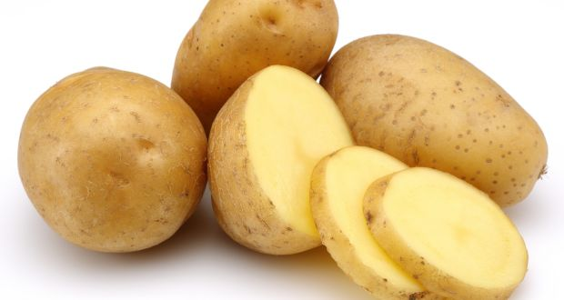
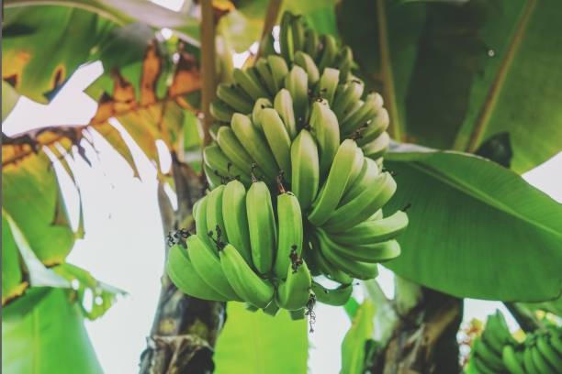
Proposal
Biodegradable carry bags are carry bags made out of :
corn-based materials, like polylactic acid Granules . Biodegradable plastic bags are now a days as strong and reliable as traditional (mostly polyethylene)-bags. Many bags are also made from paper, organic materials, or polycaprolactone.
We are focused on corn based polylactic acid Granules
It is total extract from conventional corn,potato,banna pee which contain 15%,10%,5% PLA( Poly lactic acid ) which is a polymer based by using this in granules form
That granules is our raw materials for bio-degradable Plastic

Slide 7
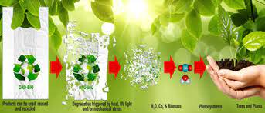
Process
Bio-Degradable Granules is heated up in certain degree temperature with the exclusion unit a balloon like film comes as per our customized size it takeoff upside with the help of rollers attached and cooldown and rolls in the roller that film again feed to cutting and sealing machine we cut and seal as per our requirement finally the handle shape is punched in the punching machine so that it will cut a customized shape and design like D W C cut now our carry bag is ready for use.

Slide 8
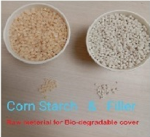
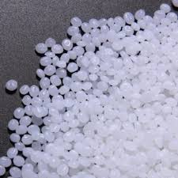
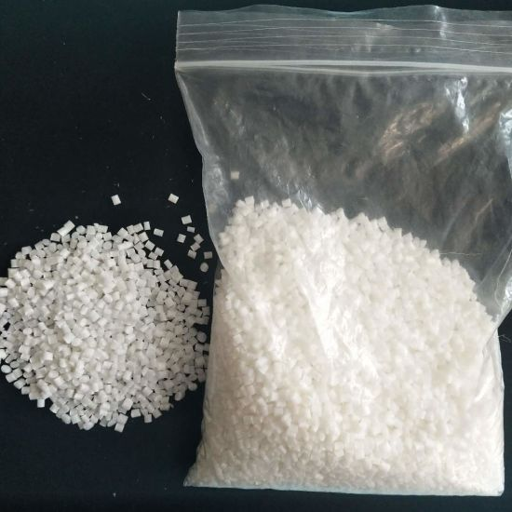
Raw Material
Raw materials are use made with
PLA( Poly lactic acid )
is a thermoplastic polyester formally obtained by condensation of lactic acid with loss of water.
It can also be prepared by ring-opening polymerization of lactide
PLA has become a popular material due to it being economically produced from renewable resources. In 2010, PLA had the second highest consumption volume of any bioplastics of the world
The monomer is typically made from fermented plant starch such as from corn, potato, banana peal cassava, sugarcane or sugar beet pulp.

Slide 9
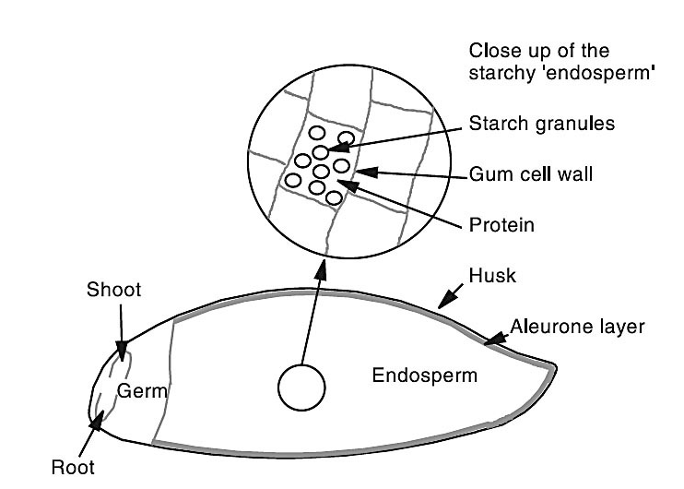
PLA (Poly Lactic Acid)
PLA (polylactic acid) is typically made from the sugars in corn starch,Potato,bannan pee, sugar cane It is biodegradable, contain Polymer carbon-neutral and edible. To transform corn into plastic, corn kernels are immersed in sulfur dioxide and hot water, where its components break down into starch, protein, and fiber.

Slide 10
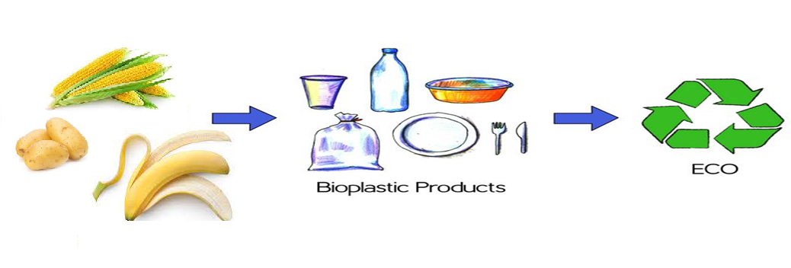
Uses of Bioplastics
Bioplastics are currently used in disposable items like packaging, containers, straws, bags and bottles, and in non-disposable carpet, plastic piping, phone casings, 3-D printing, car insulation and medical implants

Slide 11
Manufacturing process Bio Degradable carry bags

Slide 12
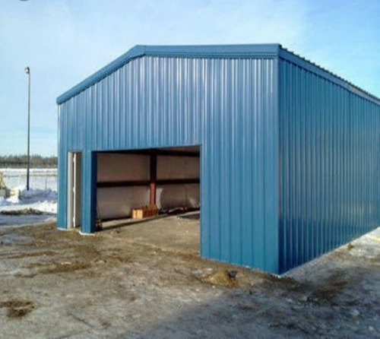
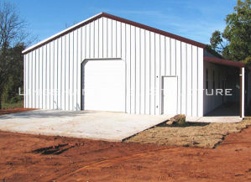
Infra structure Requirement
2000 Sqft of buildup area
Height of the building about 20 foot for excluder machine.
45 kv industrial power supply line.
Water line for cooling tower very little amount only .
Fully ventilated with air flow freely.
Two No of fire cylinders for fire fighting.as per the department guidelines
First Aid kit
Labour aprons as per the labour department guidelines.

Slide 13
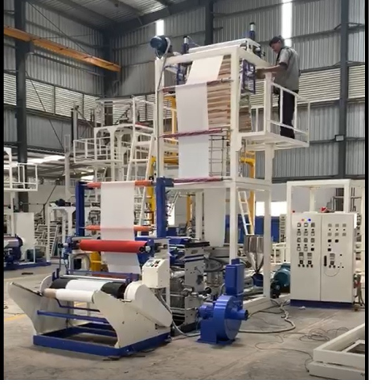
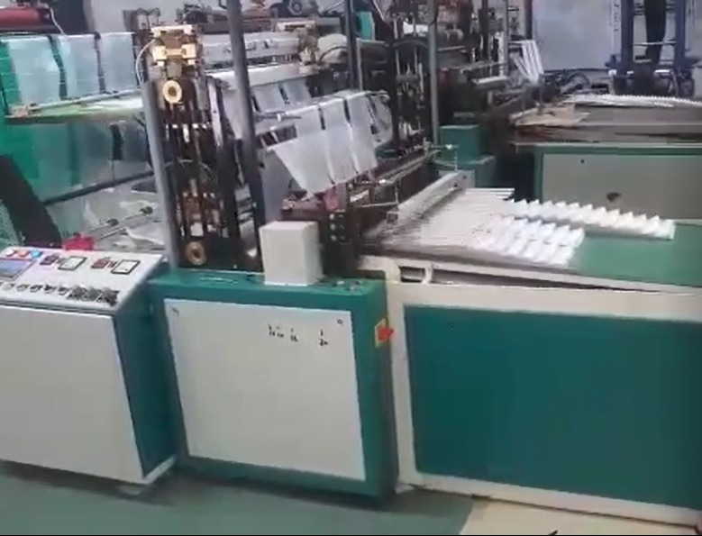
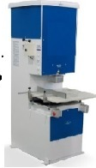
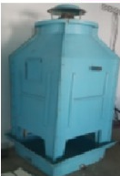
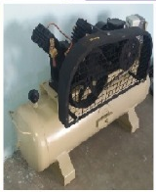
Machines used
Extruder Machine (45mm Bio-degradable. 32Nip Roll)
High Speed Cutting & Sealing Machine Double Line Loading System
Heavy Duty Punching Machine
Cooling Tower
Heavy Duty Air Compressor
Printing machine.

Slide 14
Extruder Machine (45mm Bio-degradable. 32Nip Roll)
Extruder Machine Convert
Granules into film in some
Temperature as per the setting
Size and thickness (microns ).
that film will blow upside up to
16ft height starts rolling with
the rollers arrange upside and
Cool down, Online Logo printer ,Prints
The logo, company name, licence No
Up to 4 inches and cover rollers
and form roller of the film
Machine will produce 60 Kgs per hour Capacity

Slide 15
High Speed Cutting & Sealing Machine Double Line Loading System
High speed cutting and sealing will cut and seal the cover as per our requirement and size with auto counting as per sitting and puts a side after count complete with a conveyer belt attached to it at a time 6 rolls of 30 kg each can be load with double line fitting after count a bunch. Of carry bags customize count will move as side then that bunch is feed to punching machine

Slide 16
Heavy Duty Punching Machine
Heavy Duty Punching Machine will Punch the handle as the customized size and shape the different handle design die will be provided with the machine like D cut, W cut, C cut as per customer needs.

Slide 17
Cooling Tower
Cooling tower which cools the machine when it will be runs 24 hours also this is the safety for machine.

Slide 18
Heavy Duty Air Compressor
Heavy Duty Air Compressor will supply the air to the machine when ever it required fully automatic it will cut off when it fill the tank

Slide 19
Cost benefit analysis vis a vis Conventional carry bags
Conventional carry bags
In market it available rates
1KG plastic carry bag cost Rs 140/-
Count for 1kg is 80 no's if we take size 10 x 16
So here we are getting only 80 nos only
Because the plastic carry weight is more the bio degradable carry
Bio- degradable carry bags
In the market available rates
1kg Bio – Degradable carry bag cost Rs 280 /-
Count for 1kg is 120 no's if we take size 10 X 16
So here 40 no's of carry bag is extra we are getting Here.
So as per above concept the Bio-Degradable carry bags is almost the equal rates only .

Slide 20
Production cost
One month production cost if runs for 8 hours
Production capacity of machine per hour 60 kgs
Daily runs 8 hours 60 x 8 = 480 kg we take only 400kgs
For 25 days for a month production capacity is 10,000 kgs say 10 tons
Raw material required for one month production is 10 tons
Cost of Raw material is Rs 260 per kg for resin and Rs 110 per kg filler we need two types of bio-degradable granules
Proportion we use for 1kg resign we have to add 25 % of filler is cost is 260 + 27.5 = 287.5 /1.25 kg =230 kg raw materials cost .Rs 230 x 10,000 tons =23,00,000-00 for 1 month cost of raw material
Rent =15000 per month
Emi =30,000 per month
Power Bill = 15000 per month
Employer salary = 4 nos x 15000 = 60,000-00
Mislanenies charges =20,000-00
Deprecation of machinery 0.5% =13000 -00
Per month production cost is = 1,53,000 + raw material cost = 23,00,000-00
The production cost is 1,53,000+2300000=24,53,000-00

Slide 21
Selling price basis Per month if we run for 8 hours
Our production 10 tons if we run for 8 hours
Sale @ 280 Rs per kg
For 10 tons we can get 10000 x 280 Rs = Rs 28,00,000-00
so the selling price for 10 tons if we run for 8 hours is
Rs 28,00,000-00 Net

Slide 22
Margins
Net margin if we run plant for 8 hours is
Production cost – selling cost
24,53,000-00 – 28,00,000 = 3,47,000-00 Net profit
Net Margin if we run plant for 16 hours per day
3,47,000 x 2 = Rs 6,94,000-00
NET PROFIT FOR 1 month = Rs 6,94,000
Net Profit for 1 year = 6,94,000 x 12 = Rs 83,28,000-00
The repayment of total amount in 1 years only

Slide 23
Sizes of carry bags
As we talk about the size of the carry it will depend on The market customized size as the customer how will order he will let you know the size which he required .
As some of regular use is
3x4
6x6
9x8
10x12
13x16
16x18

Slide 24
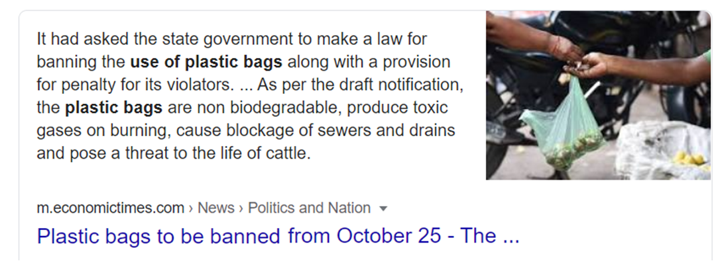
Size of market in India
Monthly 56000 MT of plastic bags are sold as the government is ban on plastic carry bags so a great demand of about 30000 Mt per month.

Slide 25
Thank you
Prepare by
Mohd sirajuddin EEE
Electrical engineer
For Bestomechines
Proprietor.
Email: mohdsirajuddin.engg@gmail.com

